Slide 1
Digital product design
Lecture 8: A/B Testing and Experiments
Alex Moehring

Slide 2
Outline
A/B Testing
Potential Pitfalls
Examples

Slide 3
A/B Testing Overview

Slide 4
Correlations and Causation
Office 365 users that see more error messages are less likely to churn (i.e. retention is higher).
Should Microsoft degrade their code to reduce churn?
Experiments are the gold standard for establishing causal relationships
An experiment that reduces errors would show a decrease in churn
Notes:
Heavy users see more error messages

Slide 5
Motivation for Experiments
Hard to assess the value of an idea ex ante
Do customers spend more if the website is blue or black?
Hard to quantify causal impact of changes / ideas on key metrics
How does a new feature impact engagement, sales, OEC
How does advertising impact bottom line?
Experiments allow us to test many ideas and quantify causal impact

Slide 6
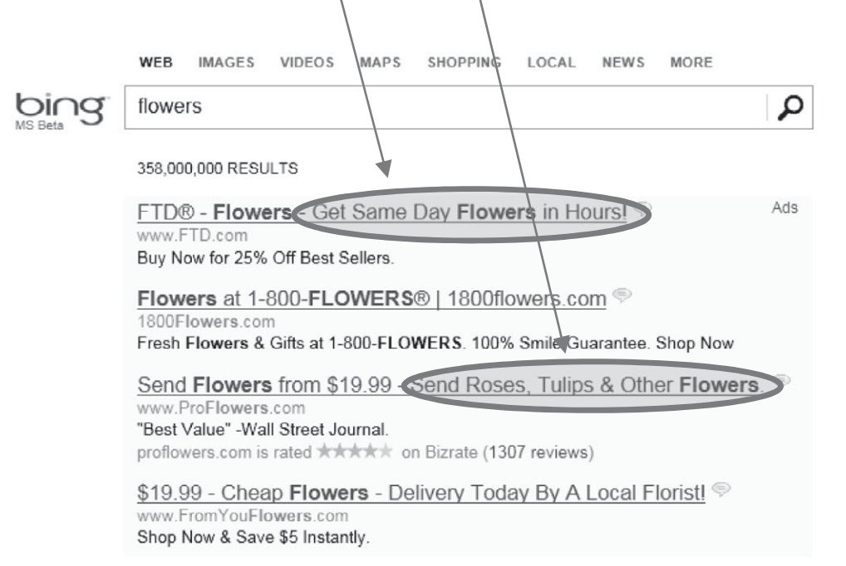
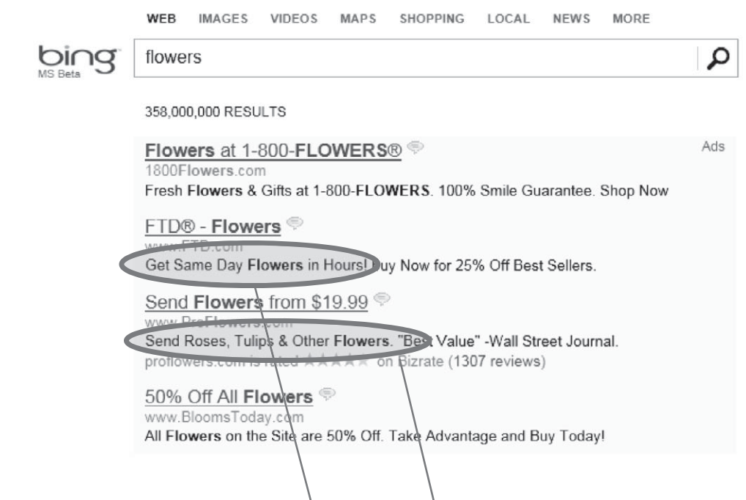
Motivation for Experiments, Continued
Source: Kohavi, Tang, and Xu
Notes:
This simple change increased revenue by $100million per year for bing

Slide 7
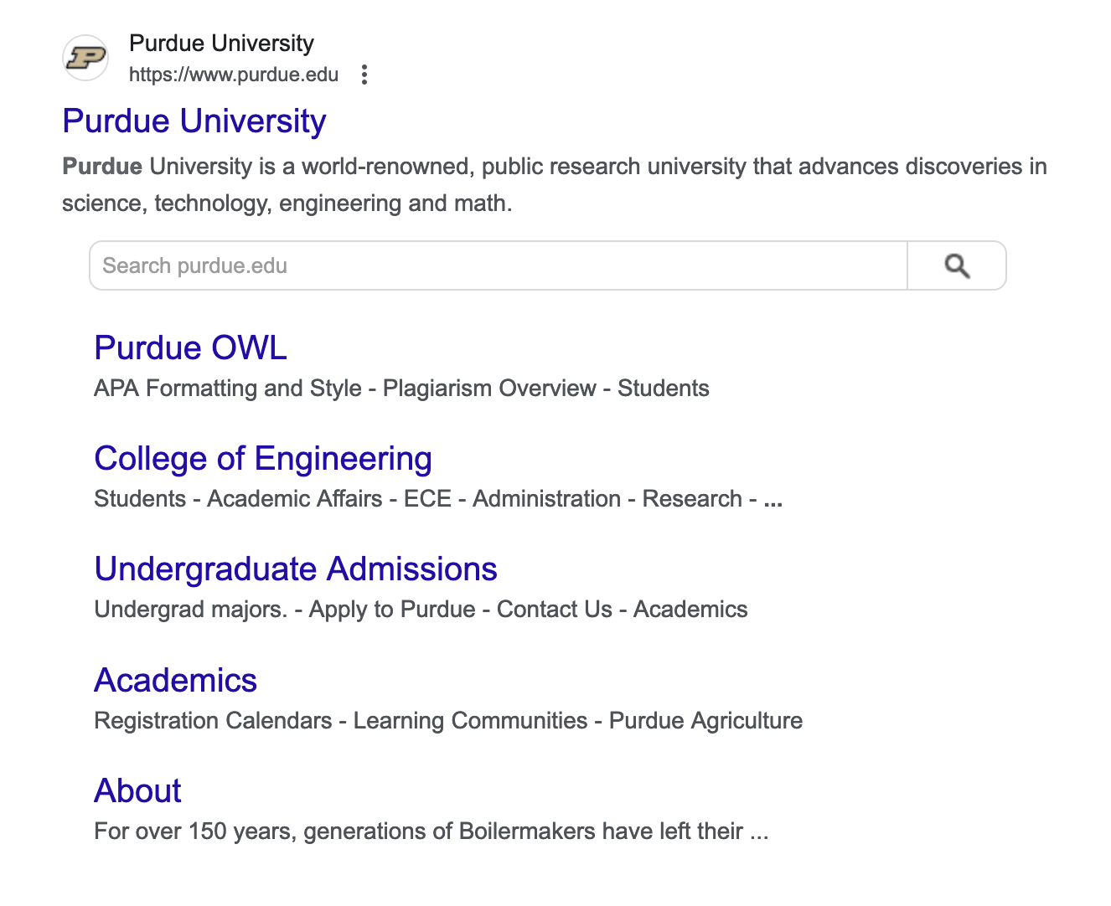
Hard to Assess New Ideas
Google tested 41 shades of blue
Head of design thought it was crazy
Turned out to matter!
Engagement increased substantially

Slide 8
Quantify Impact
Website latency impacts user experience
Users like fast websites
Engineers are expensive!
How to determine if it is worthwhile to hire an engineer to reduce latency?
Microsoft has run many such experiments
Found that 10 millisecond decrease in latency pays for an engineer
Takes ~200 milliseconds to blink an eye
Notes:
Heavy users see more error messages

Slide 9
Running A/B tests

Slide 10
Choosing the Unit of Randomization
Determine what you will randomize into the different treatment arms
User, user-session, page, day, store, …
Decision balances:
Feasibility: Can we randomize at this level?
E.g. hard for Walmart to randomize at customer level in its stores
Power
Randomizing at most granular level usually good for statistical power
Interference concerns
Do units interact with each other?
Notes:
Feasibility: User or user-session level

Slide 11
Randomize then Analyze
Randomly split traffic between two (or more) versions
Version A: Control, often the status quo
Version B: Treatment, includes some changes
Collect metrics of interest
Test for differences between the groups
We call the difference the estimated treatment effect
Question: Is assigning the first 500 customers to treatment and the next 500 to control a good way to randomize? Why not?
Randomization does not mean arbitrary assignment

Slide 12
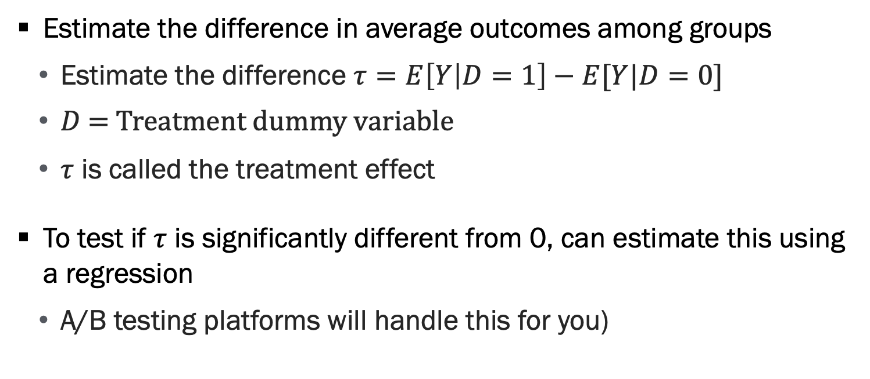
Analyze Differences
Estimate the difference in average outcomes among groups
Estimate the difference $τ=E\left[Y | D=1\right]−E[Y|D=0]$
$D$ = Treatment dummy variable
$τ$ is called the treatment effect
To test if $τ$ is significantly different from 0, can estimate this using a regression
A/B testing platforms will handle this for you)

Slide 13
Statistical Hypothesis Testing
We want to know how likely the difference between treated and control would occur by chance
Typically involves calculating p-values and confidence intervals
Hypothesis testing gives us a way to do this
Null hypothesis: Treatment effect = 0
Alternative: Treatment effect is not zero
p-value: Probability under the null hypothesis of observing an absolute treatment effect at least as large as what we observed

Slide 14
Analyze Differences - Heterogeneous Treatment Effects
Heterogeneous treatment effect: How the treatment impacts groups differently
Estimate the treatment effect among sub-groups and compare
You can also nest this in a single regression
Example: Estimate treatment effect among mobile users and desktop users

Slide 15
Potential Pitfalls

Slide 16
When Experiments Fail
Randomization fails
Interference
Statistical problems
Ethics and experimentation

Slide 17
Randomization Fails
Actually randomizing users can be hard
A/A Tests are useful to test the experiment pipeline
Easy to test for mistakes implementing randomization
Two useful tests to run
Sample ratio mismatch: Test that the share of users receiving each treatment equal the expected shares
Balance tests: Test that the treated and control groups have similar pre-treatment characteristics

Slide 18
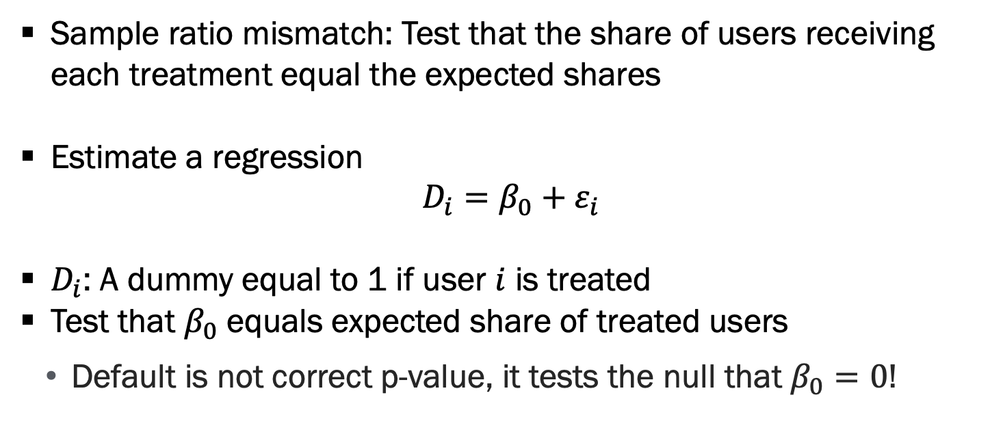
Sample Ratio Mismatch
Sample ratio mismatch: Test that the share of users receiving each treatment equal the expected shares
Estimate a regression
$$D_{i}=β_{0}+ε_{i}$$
$D_{i}$: A dummy equal to 1 if user $i$ is treated
Test that $β_{0}$ equals expected share of treated users
Default is not correct p-value, it tests the null that $β_{0}=0$!

Slide 19
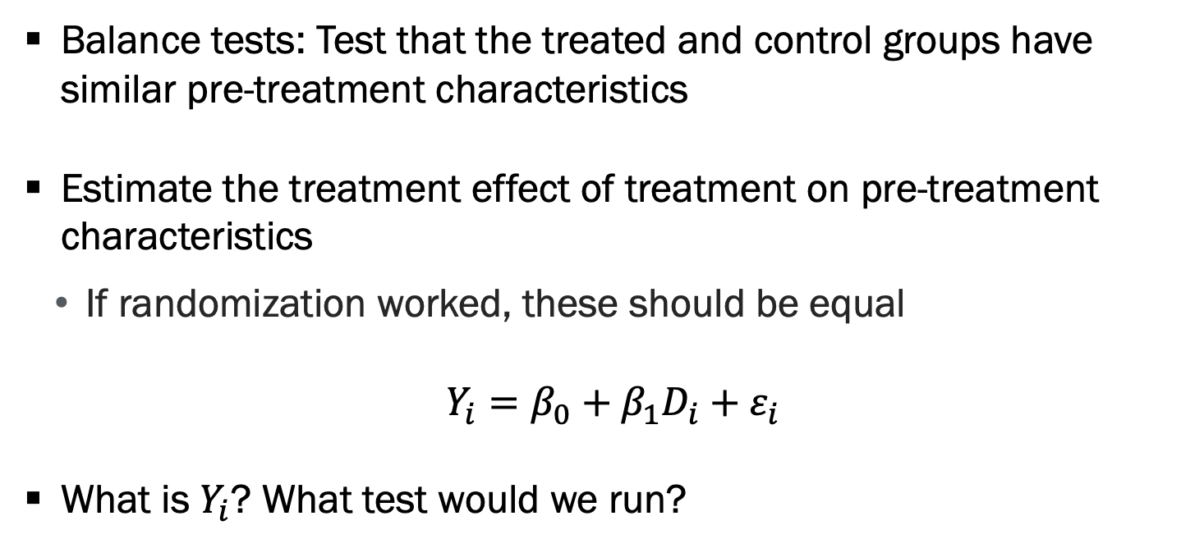
Balance Tests
Balance tests: Test that the treated and control groups have similar pre-treatment characteristics
Estimate the treatment effect of treatment on pre-treatment characteristics
If randomization worked, these should be equal
$$Y_{i}=β_{0}+β_{1}D_{i}+ε_{i}$$
What is $Y_{i}$? What test would we run?

Slide 20
Interference
Interference occurs when units in the experiment interact with one another
Examples:
Marketplaces: If we treat some sellers but not other, do they have a competitive advantage?
Networks: If treatment impacts my posting behavior, this impacts control users who interact with me
Traditional statistical analysis if incorrect if interference is present

Slide 21
Interference - Solutions
Randomize at a higher level where interference concerns are less severe
Examples:
Marketplaces: Randomize at the market level (i.e. Etsy product category)
Networks: Cluster randomization (i.e. randomize friend groups who frequently interact)

Slide 22
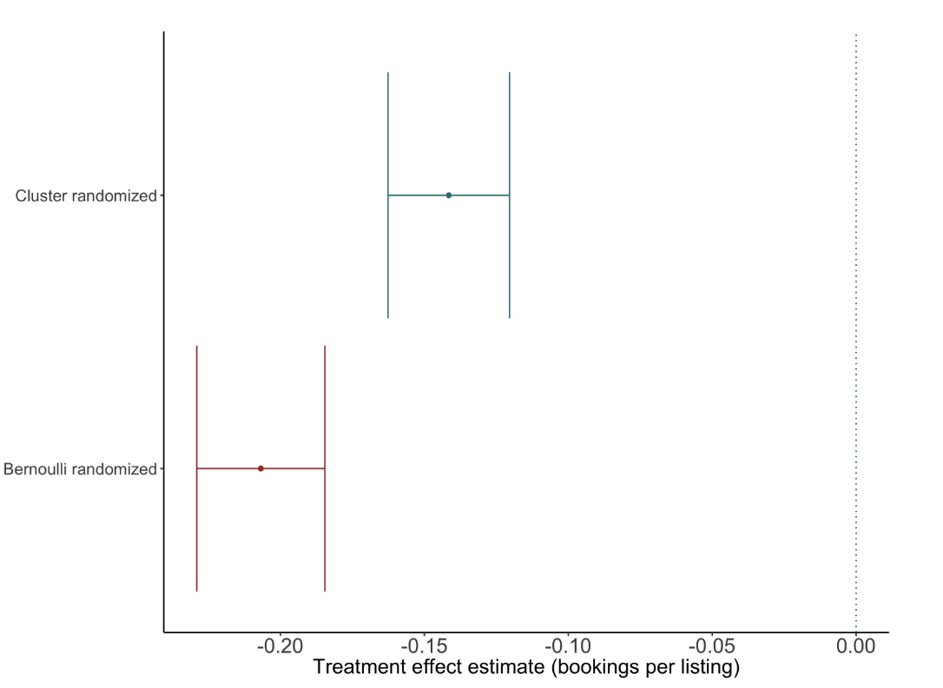
Interference – Holtz et al (2020)
Airbnb determining how its fee impacts demand
There is interference as higher fee impacts prices and competition
Naïve randomization overestimates the elasticity of demand
Clustering similar units leads to better estimates

Slide 23
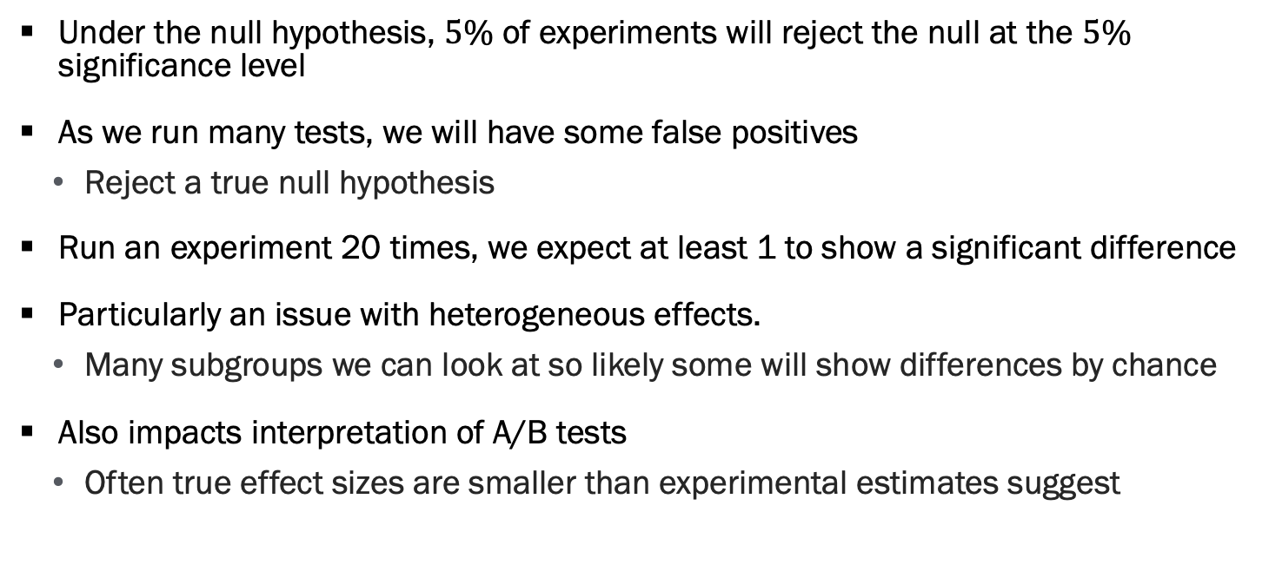
Statistical Problems – Multiple Hypothesis Testing
Under the null hypothesis, $5\%$ of experiments will reject the null at the $5\%$ significance level
As we run many tests, we will have some false positives
Reject a true null hypothesis
Run an experiment 20 times, we expect at least 1 to show a significant difference
Particularly an issue with heterogeneous effects.
Many subgroups we can look at so likely some will show differences by chance
Also impacts interpretation of A/B tests
Often true effect sizes are smaller than experimental estimates suggest

Slide 24
Statistical Problems – Peeking
If I look at the data every day, this is a version of the multiple testing problem
Leads to an elevated false positive rate

Slide 25
Statistical Problems – Solutions
Solution is to use statistical inference that corrects for multiple comparisons or anytime valid inferences
Beyond the scope of this course
Many testing platforms have this built in
If you encounter, know this is an adjustment for these issues

Slide 26
Ethical Experimentation
Many experiments businesses run involve minimal risk to participants
There is often limited oversight of experiments in industry
Establishing a culture of ethical experimentation is important
An internal IRB can be helpful in reviewing tests
Academic experiments regulated by the Belmont report
Focuses respect for persons, minimizing risks, and justice (fair distribution of risks / benefits)

Slide 27
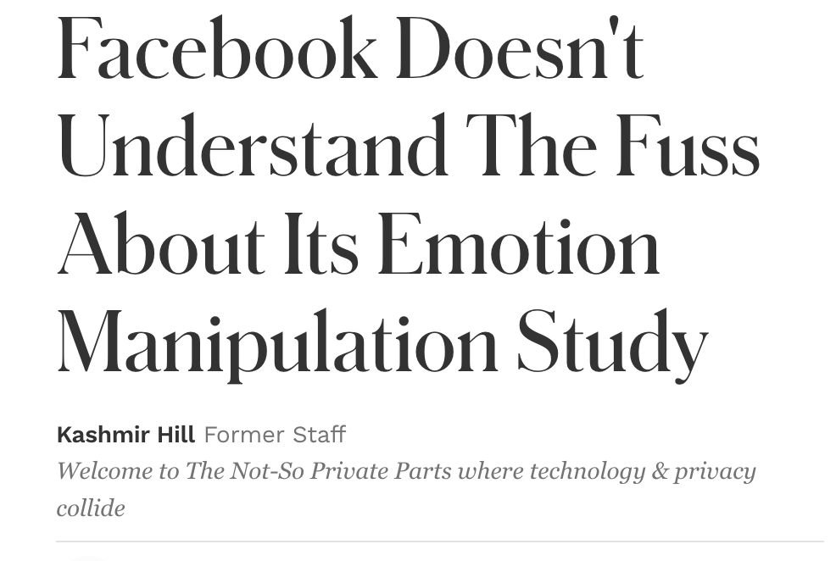
Examples of Problematic Experiments
Facebook promoted negative content to some people to test emotional contagion
Found that negative content induced people to post more negative content
Public backlash ensued
Lack of consent was important
Notes:
Ask for classes reaction

Slide 28
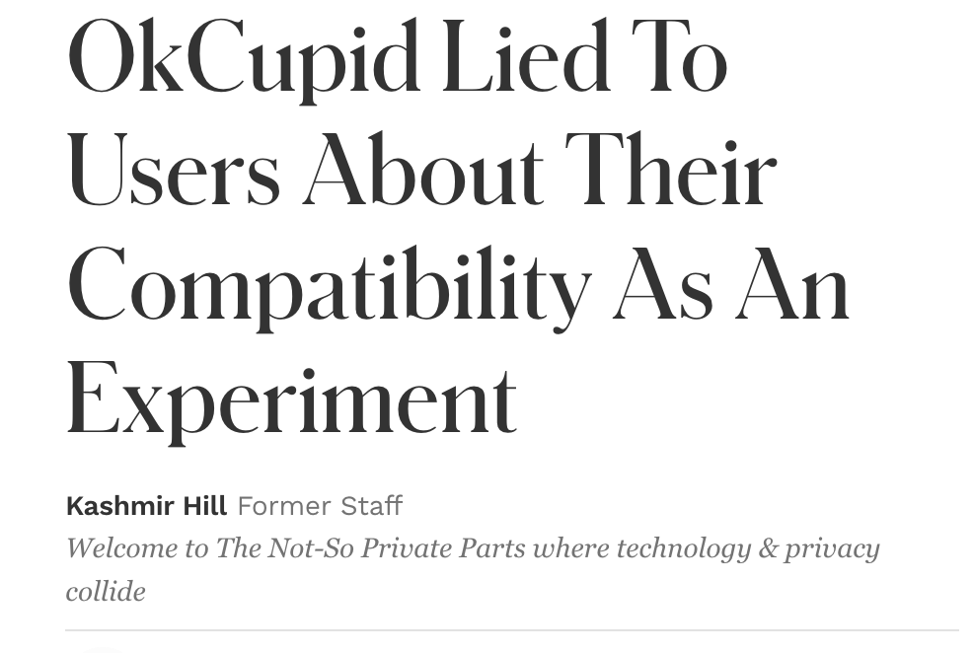
Examples of Problematic Experiments, Continued
OkCupid randomly altered its match scores it showed users
Goal was to see if they are predicting or causing relationships
Public backlash ensued
Deception was key concern

Slide 29
Ethics in Experiments
There is active debate on the ethics of such experiments
Key concern is:
Trading off benefits and risks
Ensuring participants are treated as autonomous users
A useful question:
Would you deploy this change to 100% of users without testing?
“Wall street journal” test is also a useful thought experiment

Slide 30
A/B Testing Strategy

Slide 31
A/B Tests Aren’t Run in a Vacuum
If we allocate sample to test one idea, it often takes sample away from testing another idea
There is a tradeoff between testing many ideas with small sample-sizes vs few ideas with big sample sizes
How do we decide which is better?
“A/B Testing with Fat Tails” by Azevedo et al (2020)
The paper is dense

Slide 32
When Few Big Experiments are Optimal
If ideas are predictable and tend to have marginal improvements best to run fewer larger experiments
Carefully triage ideas
Identify the most promising
Because effects tend to be smaller, large experiments let us identify the positive-payoff

Slide 33
When Many Small Experiments are Optimal
When ideas are plentiful and there are “heavy tails” best to run many small experiments
This means there are many ideas with outlier payoffs
The idea is that it is important to find these outlier ideas
Hard to identify ex ante
Because effects are big, they can be found in smaller experiments
This method will not reliably identify the ideas that have small positive impacts
Worth the tradeoff to find the home-run ideas

Slide 34
What is Best for Our Company?
How easy is it to run experiments?
In online world, often relatively easy
Do ideas have “fat-tailed” payoffs?
In new ventures, often yes as there are many low-hanging fruit
Surprisingly, often true in big organizations as well
Azevedo et al (2020) found Bing had very fat tails

Slide 35
Mini Case study

Slide 36
What is Best for Our Company? Continued
Facebook’s revenue has been relying heavily on advertising. In early this year, Facebook reported advertising revenue at $16.6 billion for the final quarter of 2018, up 30 percent year-over-year. Facebook news feed ads allow businesses to run targeted campaigns that appear as posts in Facebook news feeds.
Imagine yourself as a PM for FB news feed ads team. You are interested in increasing ad-revenue and want to measure user sensitivity to ads.
Describe an experiment that would allow you to estimate this quantity
What challenges do you have to overcome here?

Slide 37
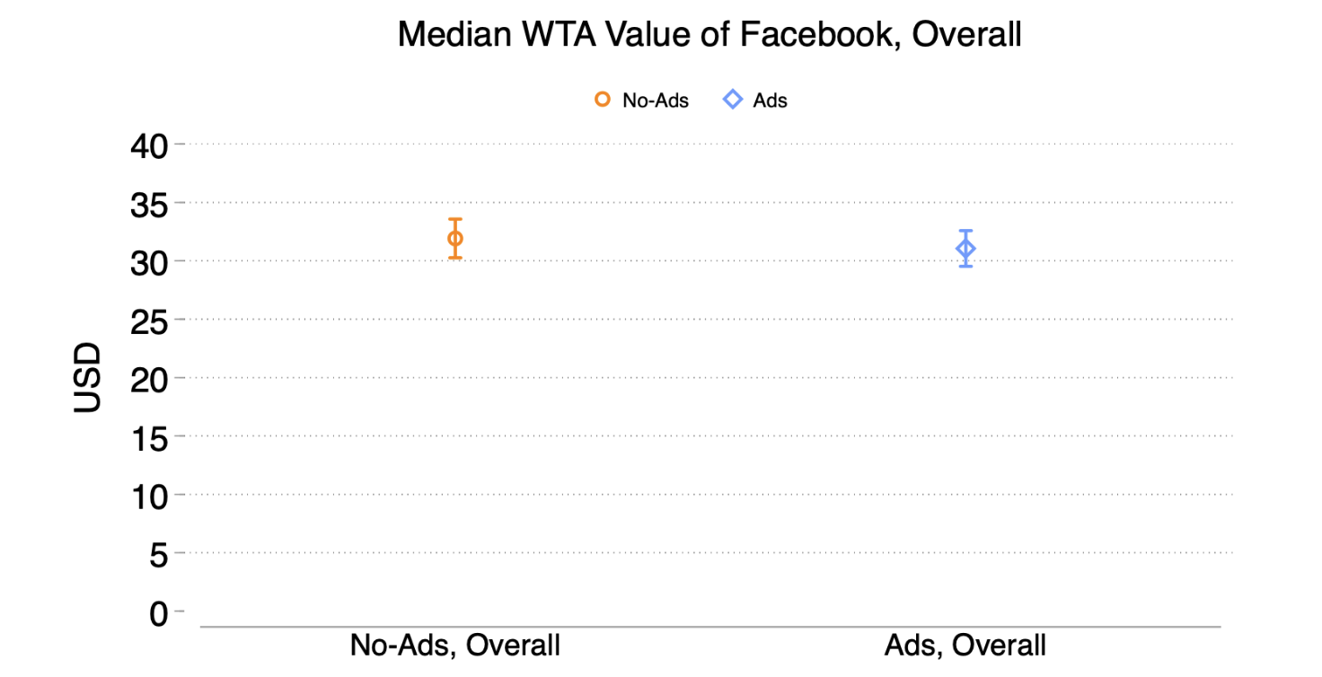
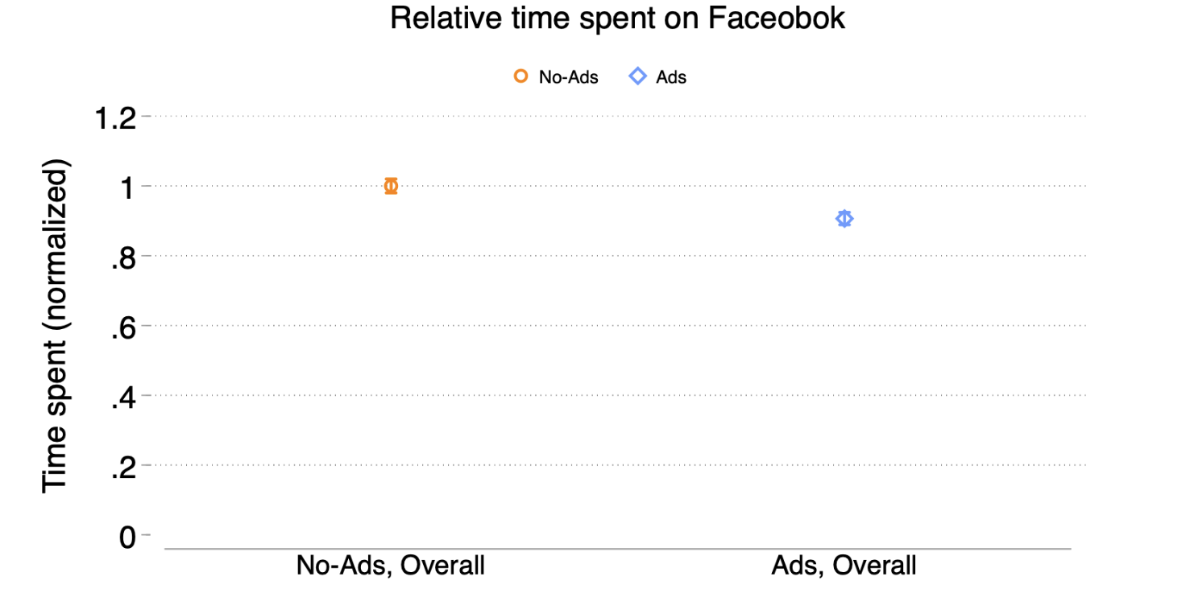
Facebook Ran a Version of Experiment
Source: Brynjolfsson et al (2024)

Slide 38
Questions?

